Slide 1
Ense 470 milestone 7
Jeremy Cross
Iden Ellia
Abdullah Alasmari

Slide 2
Introduction
We will be reviewing Team Covfefe’s application
www2.cs.uregina.ca/~thoma26s/ense470/splashpage.php

Slide 3
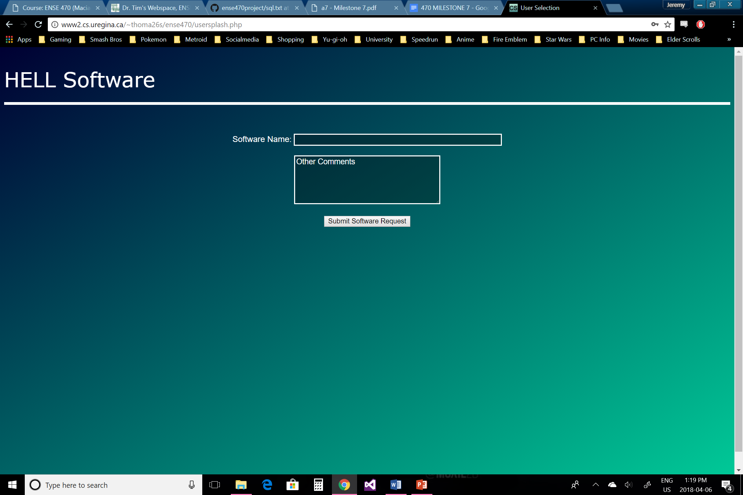
User Perspective

Slide 4
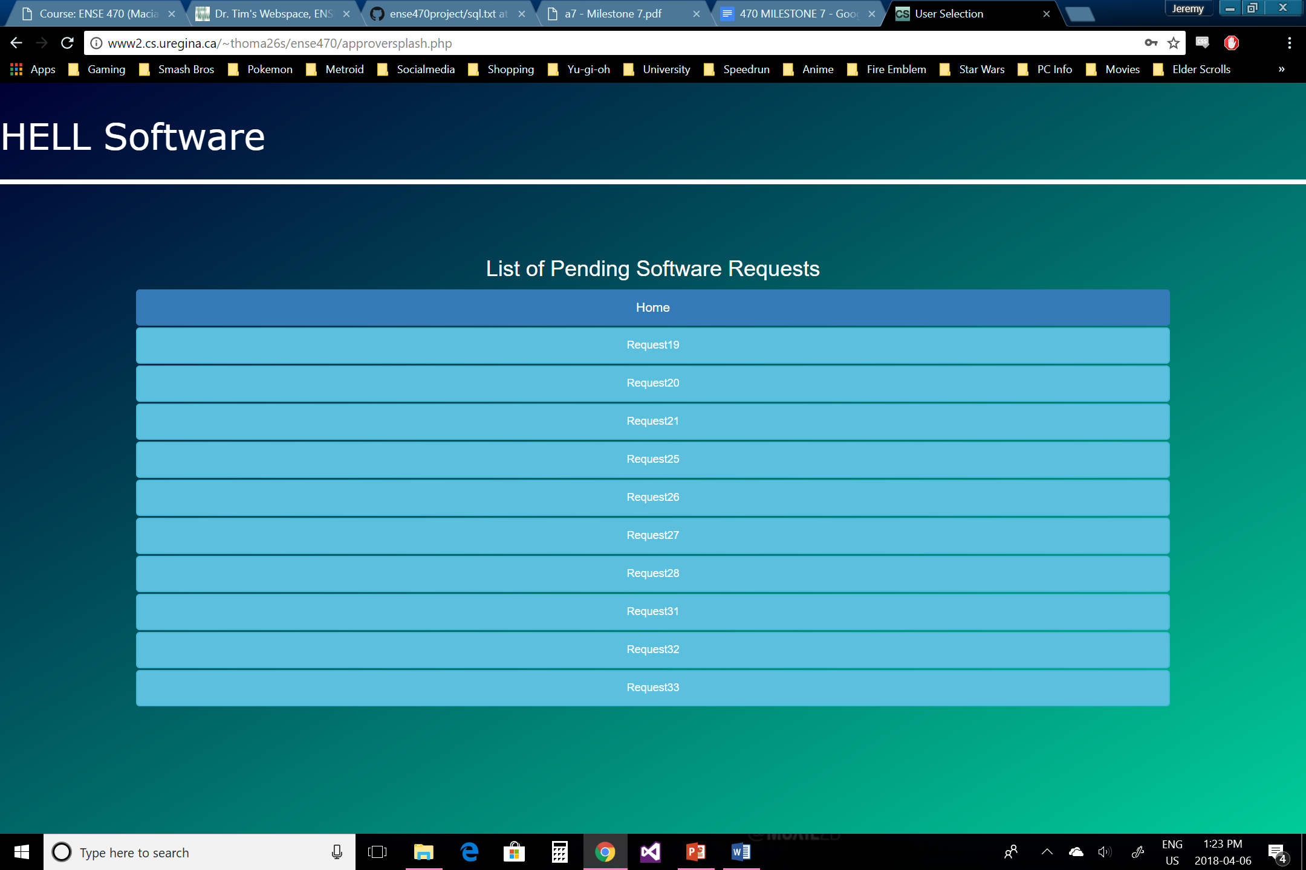
Approvers Perspective

Slide 5
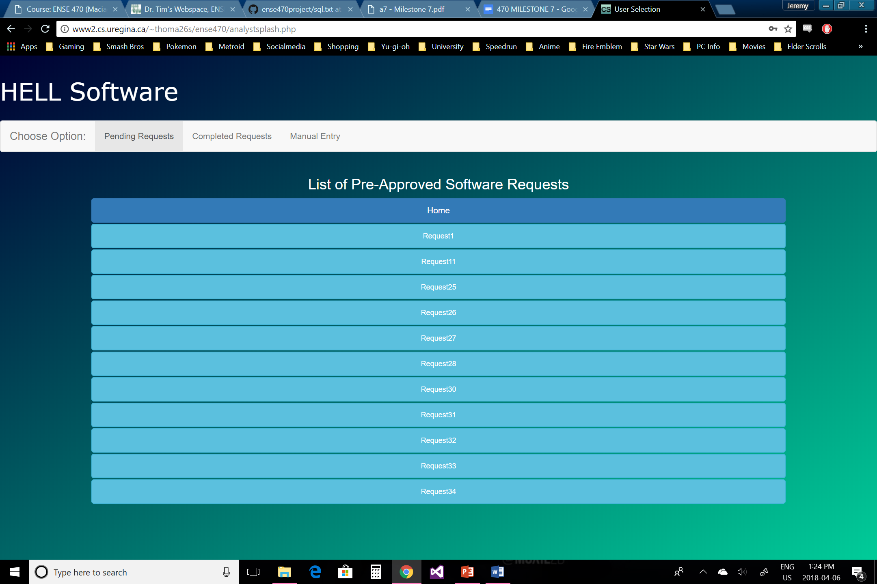
Analyst perspective

Slide 6
Team GitHub review
Is the team’s GitHub readable?
Log in or show a quick visual/snapshot of their GitHub
Does the team provide good documentation?
Is your team able to understand the file/folder names/structure (flow)?
Would your team be able to easily and quickly pick up where they left off?
Do you have any comments/guidance for the team in this area?
Ok if no – if things are awesome though, explain why you think so

Slide 7
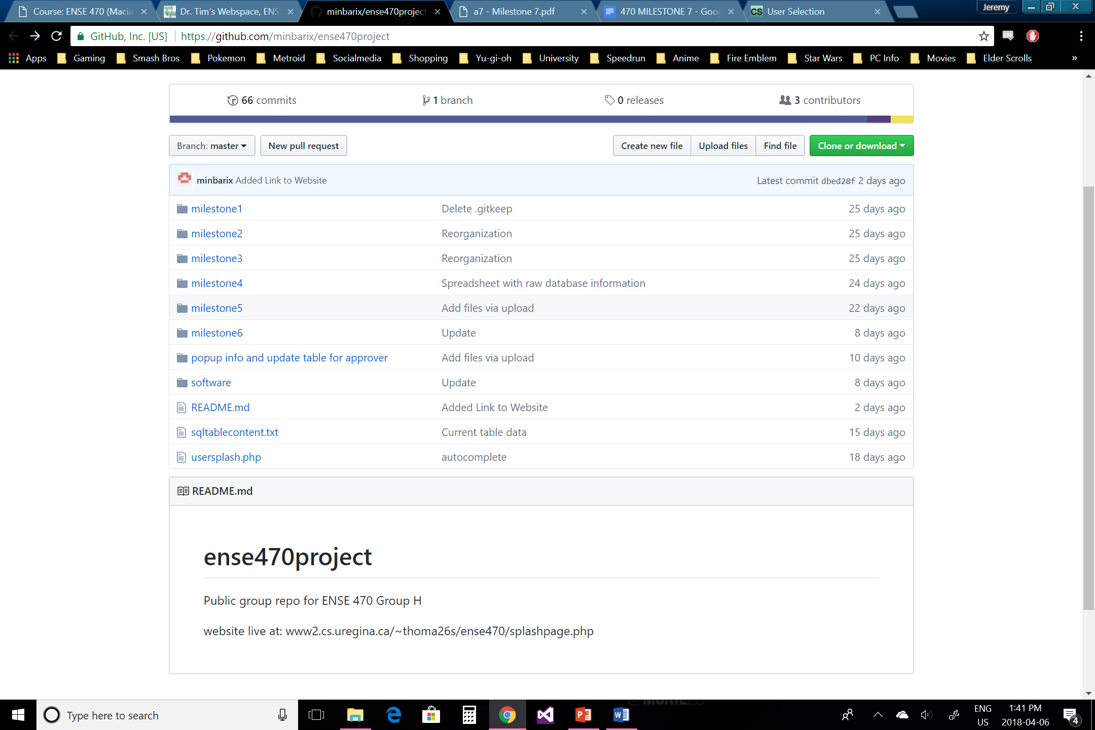
Team covfefe review
There GitHub page well organized with everything having its own folder
The folder names are labeled correctly and correspond to what's in them
The documentation could maybe provide a bit more detail
Overall the organization of the GitHub page is good and it wasn’t to difficult to find where to locate things

Slide 8
Refactor review (High-level focus)
Is the team’s code obvious/readable for other programmers
Will others understand what’s going on?
Does your team understand what is going on?
Does the code provided as-is appear easy to maintain? – yes/no – Why?
Do all tests pass?
Is the team’s ATDDs easy or hard to find on GitHub, discuss
Focus/validate ATDD tests provided from Milestone 5 (simply confirm that they work)
Were any key ATDD tests missed? (you may have to review their user story map)
Code smells
Are there any bloaters, object-orientation/method abuser, change preventers, dispensibles, couplers?
If yes to the above, what refactor methods would you use to fix things up?
Provide code samples
Remember what refactoring is not!
If no to the above – what makes the code so stellar?
Provide code samples

Slide 9
Refactor review
ATDD templates
Most of the tests passed/failed as intended
Some didn’t because maybe either the functionality was wasn’t fully complete or it didn’t quite work as intended
All the templates are accounted for on the user story map
Templates are accessible through the milestone 5 and 6 presentations but were not posted individually, However, they were not to difficult to find

Slide 10
Refactor review
Code For Application
sdsdsd

Slide 11
Refactor review
Code Smells
jh

Slide 12
Design pattern discussion (High-level focus)
Comment on what design patterns the team used
Provide samples where you are able
Were they appropriate?
Were there alternatives they could have also used?
If they didn’t use any Design Patterns, were there ones they could have tried?
Provide samples/code snippets/areas of the code

Slide 14
Reviewed team’s response
Ask the reviewed team if they have any questions or comments. This in the spirit of positive non/critical discussion and/or debate

Slide 16
Group reflection
How did you feel about this milestone? What did you like about it? What did you dislike?
It was interesting looking at a different approach to designing the application
It adds different perspectives seeing different design approaches
What did you learn about yourself as you collaborated and worked through this milestone?
Things that we could have improved on ourselves, by looking at what team Covfefe had or was missing
How will you use what you have learned going forward?
We can use the feedback that we receive for the group reviewing our application as well as ideas from reviewing team Covfefe’s application in the future
What “stuff & things” related to this milestone would you want help with?
For the most part we were fine

